Slide 1
CSC 177
Data Analysis & Mining
Contributed By: Lauren Prather, Vibhore Sagar, Rachel Mao, Santiago Bermudez, Mueed Khalid, Marco Toro, Jared Roque

Slide 2
Part 1: Work we are proud of
We are incredibly proud of our team and our team work, we were all able to work without hassle and get all out projects done correctly and on time.
Asking for help from each other and removing any roadblocks.
We were incredibly lucky to have good teammates who are good with time management and were able to properly allocate time for each project.

Slide 3
Part 2: insights we gained
Project 1:
1: Insight on Preprocessed Data:
Not preprocessing data can lead to the data set to false prediction or an outcome not true.
Our mean, standard deviation, outliers, etc. of the data set can be significantly different from raw vs preprocessed data.
Preprocessed data will help transform our raw data into the cleanest data set possible for our testing.
2: Possible Effects on Prediction:
Having a clean dataset can conclude to more accurate predictions or outcomes of test.
Ex: Our dataset of the titanic concludes the standard deviation of survival 0.5. Using a dirty data set can fluctuate our standard deviation of survival if we had missing data or include duplicates values.

Slide 4
Part 2: insights we gained
Project 2:
3: Understood the importance of not overfitting or underfitting our data
Ex: when classifying the given dataset we found that we could select entropy as our attribute selection measure and use a maximum depth of 5 for the tree. This increased our accuracy from 80% to 83%
We kept in mind that choosing a higher value for maximum depth can cause overfitting and choosing a lower value can cause underfitting.

Slide 5
Part 2: insights we gained
Project 3:
Insight 4
Applying various classification on our dataset was incredibly helpful. This helped us learn how to work with different models in a dataset.
Tree classification was the most accurate for our model compared to other classifications that were applied.
Project 4:
Insight 5
For data processing, preprocessing the dataset before hand and cleaning it was helpful.
For this project, the decision tree was the most accurate followed by ANN.

Slide 6
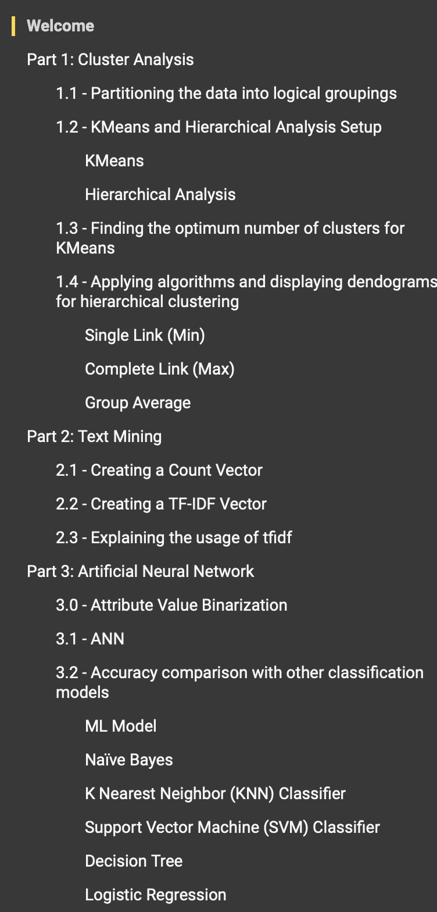
Task Distribution and Organization
Distributed by parts and availability to collaborate.
Some parts broken up into different sections due to amount of task, which would lead to dependency and collaboration for some group members.
Organization kept in Google collab, with the table of context broken into every part of the project. Along with every task that was completed for a part.
Notes:
For task Distribution, it was a little challenging as many of us in the group had different availability and creating a meeting to go over project and discussing which parts everyone would work on, was very limited. However, some of our group member found it a little easier to collaborate with other and would take on parts that require more of a collaboration. For parts that seemed like they could be worked on individually, those would be distributed to groups members who had busy schedules to collaborate. A few instances we would reach out to other and have small forms of collaborations, when needed. For the organization portion of all our projects, all parts and task of projects were done in google collab. Each part of the project was stored in our table of context along with each subtask we did.

Slide 7
Methodologies
There were several methodologies that were used and varied by project as each project had different goals and needs for the analysis. Some methodologies in the projects include:
Data Cleaning
Data Normalization
Data Transformation
Regularization

Slide 8
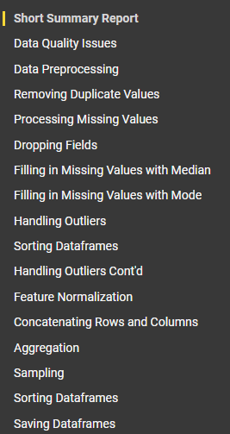
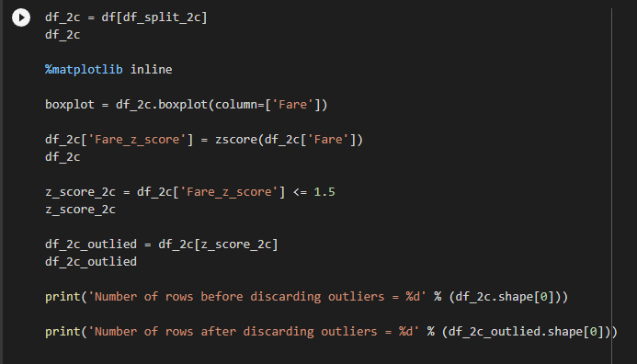
Data Preprocessing Project

Slide 9
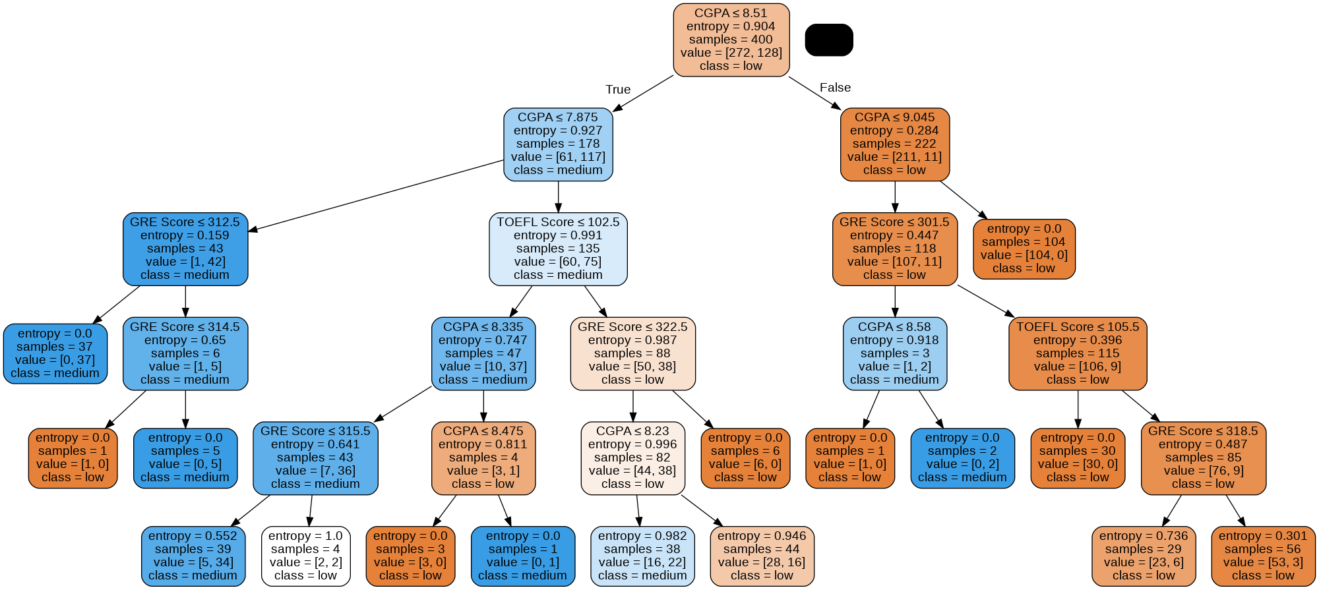
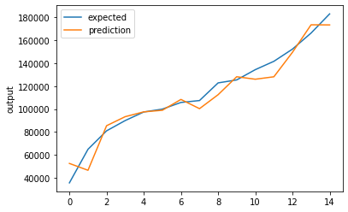
Linear Regression Project & Classification Tree Homework

Slide 10
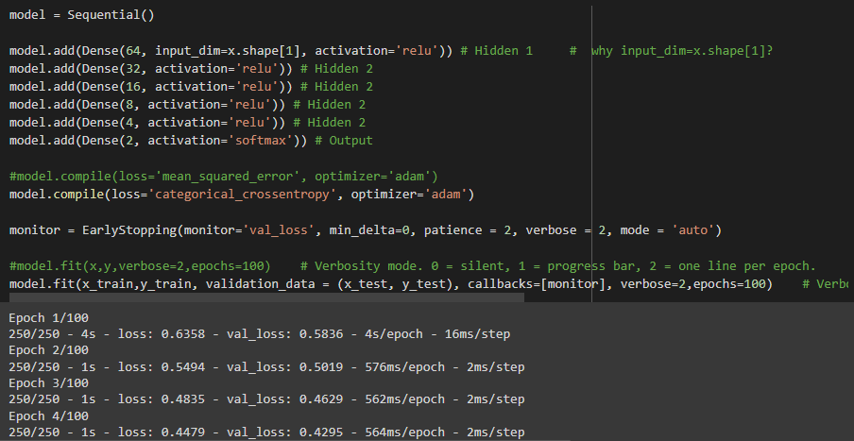
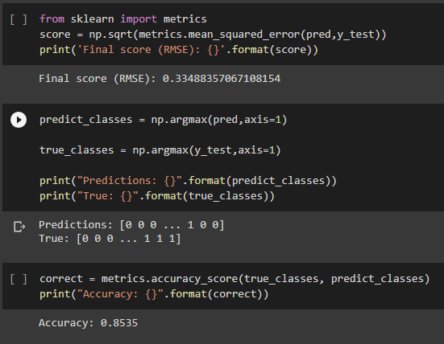
Classification Models Project

Slide 11
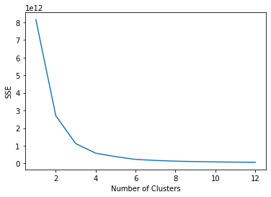
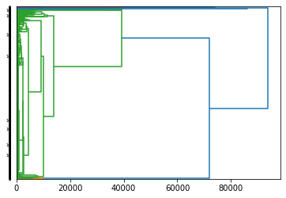
Cluster Analysis, ANN and Text Mining Project

Slide 12
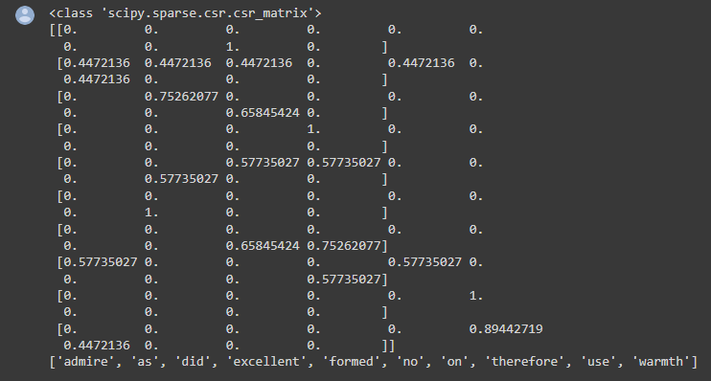
Cluster Analysis, ANN and Text Mining Project

Slide 13


Challenges and Struggles the Group Faced While Working on the Data Projects
Choosing who was in charge of different aspects of each project was difficult since each group member had different strengths and weaknesses. This challenge was solved by:
Considering the aspects of a project that each group member was most comfortable with
Calculating how many team members each part of the project would take and assigning team members accordingly
Communication was oftentimes an issue since most of the group was involved in many different courses and had different schedules. This challenge was solved by:
Maintaining consistent communication using Discord
Being available to help answer questions that another group member may have
Scheduling meetings to plan out a strategy for the next project

Slide 14
Thank you!

